Slide 1
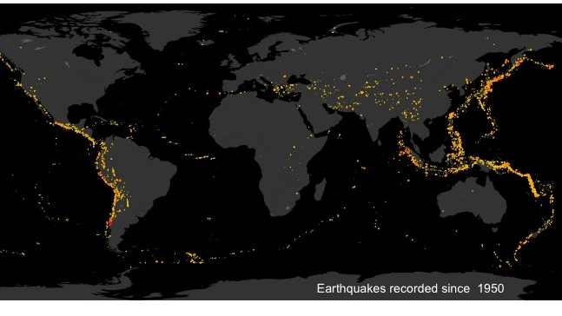
GLOBAL EARTHQUAKE ANALYSIS (1995 -2023)
Pappula Madhusudhan Reddy
MIS 7397 Data Visualization
Apr 12, 2026

Slide 2
DATA OVERVIEW
CONTENT
Source: Earthquake Dataset
Time: 1995 – 2023
Key Fields:
Date
Magnitude
Depth
Country Location
Purpose of Analysis
To evaluate how earthquake activity evolves over time
To identify geographic concentration of seismic risk
To examine whether frequent earthquake regions are also exposed to higher severity events

Slide 3
EARTHQUAKE FREQENCY OVER TIME
INSIGHTS:
Earthquake frequency shows a statistically significant upward trend
R² ≈ 0.27 shows weak explanatory power (trend exists but variability dominates)
p-value < 0.01 shows trend is statistically significant
Forecast indicates stabilization around ~39 events/year

Slide 4

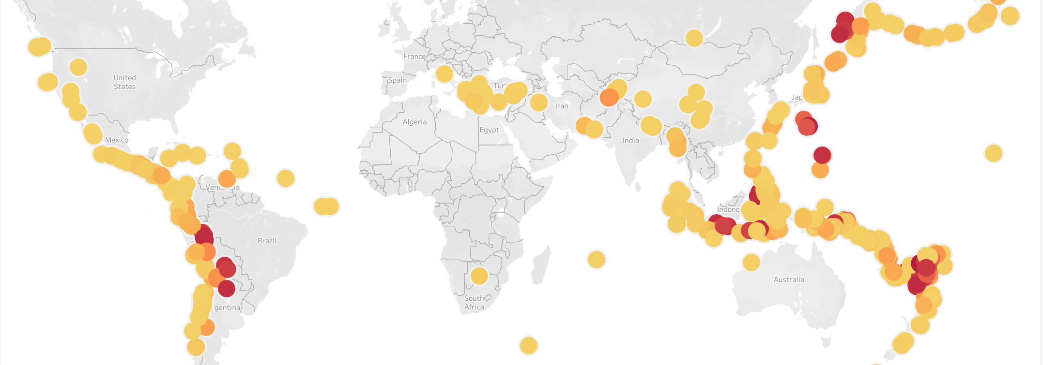
GLOBAL EARTHQUAKES BY MAGNITUDE AND DEPTH
INSIGHTS:
Earthquakes are highly clustered geographically, not random
Strong concentration along tectonic boundaries (Ring of Fire)
Depth variation indicates different seismic mechanisms within same regions

Slide 5
Earthquake Risk: Frequency vs Severity
INSIGHTS:
Earthquake activity is concentrated in few countries
These regions also show higher maximum magnitudes
Strong nonlinear relationship (R² ≈ 0.82, p < 0.0001)
Indicates high-frequency zones carry elevated seismic risk

Slide 6
KEY TAKEWAYS & RECOMMENDATIONS
KEY TAKEAWAYS:
Earthquake activity is structurally concentrated in tectonically active regions rather than globally distributed
Temporal analysis shows an increase in frequency, but with persistent unpredictability due to high variability
Risk is defined by the interaction of frequency and severity, not by either dimension alone
High-frequency regions demonstrate greater exposure to extreme magnitude events
Effective understanding of earthquake risk requires integrated temporal, spatial, and severity analysis
RECOMMENDATIONS:
Prioritize monitoring and preparedness in regions with both high frequency and high severity exposure
Develop strategies that address both recurring moderate events and rare high-impact events
Utilize nonlinear modeling approaches to better capture complex seismic relationships
Strengthen early warning systems and infrastructure resilience in high-risk zones

Slide 7
LIMITATIONS & REFERENCE
LIMITATIONS:
Country-level aggregation may mask localized seismic variations
Dataset limited to 1995–2023, restricting long-term geological interpretation
Forecasting assumes continuation of historical trends
Analysis does not incorporate tectonic plate data or subsurface geological variables
REFERENCE:
https://www.kaggle.com/datasets/shreyasur965/recent-earthquakes?select=earthquakes.csv
Tableau Desktop Documentation

